Slide 1



Hand Hygiene Practices Among Health Care Workers In JMKMCRH, May 2025
Head Shot
Michael Ruitururi
IPC FOCAL –NYANDARUA COUNTY

Slide 2

Background / Rationale
Hand hygiene (HH) is the cornerstone of Infection Prevention and Control (IPC) (World Health Organization [WHO], 2020).
Prevents healthcare-associated infections (HAIs) and reduces antimicrobial use (Debra et al., 2012).
Critical for combating antimicrobial resistance (AMR) (Pan American Health Organization [PAHO], 2021).
Poor compliance leads to increased infections → antibiotic use → antimicrobial resistance (AMR).
WHO target for HH compliance in critical care: ≥90% (WHO, 2020).
Global average is 78%(UNICEF, 2018);
- Kenyan hospitals: average compliance only 38%(Ndegwa et al., 2019).

Slide 3
Study Objectives
Major Objective
To assess the level of hand hygiene compliance among healthcare workers at JM Hospital in May 2025, and determine its implications for infection prevention and antimicrobial resistance.
Specific Objectives
To measure the proportion of healthcare workers at JM Hospital who correctly perform hand hygiene in May 2025 .
To identify the main barriers affecting hand hygiene compliance among healthcare workers at JM Hospital in May 2025.
To compare self-reported hand hygiene practices with directly observed compliance among healthcare workers at JM Hospital in May 2025.

Slide 4

Methodology
Study Design: Descriptive cross-sectional study
Study Site: JM Hospital, May 2025
Approximately 3km from Olkalou Town, along Olkalou Nyahururu Road, Central Kenya Nyandarua County
Participants: Healthcare workers who consented
Data Collection:
  • Self-administered questionnaires
  • Direct observation of hand hygiene moments
Data Analysis: Microsoft Excel & Epi Info
Presentation: Tables, charts, descriptive statistics
Ethics: Informed consent and confidentiality observed
Integrating One Health Approach and Antimicrobial Resistance in Infection Prevention and Control for Universal Health Coverage

Slide 5

Results
Total participants: 70
- Nurses: 85.7% (60/70)
- Majority had >16 years of experience
- Knowledge of HH: 100% (all respondents)
ABHR: 91.4% of HH moments
- Soap & water: less frequent
- Preference for ABHR is promising but undermined by supply/quality issues
Integrating One Health Approach and Antimicrobial Resistance in Infection Prevention and Control for Universal Health Coverage

Slide 6

Reported vs. Observed Compliance
Reported practice:
• After patient contact: 80%
• Before patient contact: 51.3%
- Observed practice:
• Before patient contact: 12.8%
• After patient contact: 40%
- Benchmark gap: Far below WHO target (90%)
Integrating One Health Approach and Antimicrobial Resistance in Infection Prevention and Control for Universal Health Coverage

Slide 7

Barriers to Compliance
Negative attitude: 20%
- Lack of paper towels: 22.8%
- Cold water: 57%
- Use of alternative (non-standard) ABHR: 42.8%
Integrating One Health Approach and Antimicrobial Resistance in Infection Prevention and Control for Universal Health Coverage

Slide 8

Discussion & Implications
Knowledge ≠ Practice (universal knowledge, poor compliance)
- Low HH before patient contact → higher infection risk
- Leads to:
• Preventable HAIs
• Increased antibiotic prescriptions
• Accelerated AMR spread
- Structural + behavioral interventions urgently needed
Integrating One Health Approach and Antimicrobial Resistance in Infection Prevention and Control for Universal Health Coverage

Slide 9
Conclusion & Recommendations
Conclusion: HH compliance at JM Hospital is far below benchmark → undermines IPC & accelerates AMR
- Recommendations:
• Regular training & sensitization on HH & AMR
• Ensure supplies: paper towels, warm water, standard ABHR
• Introduce compliance monitoring & feedback
• Promote culture change & accountability in HH
Integrating One Health Approach and Antimicrobial Resistance in Infection Prevention and Control for Universal Health Coverage

Slide 10
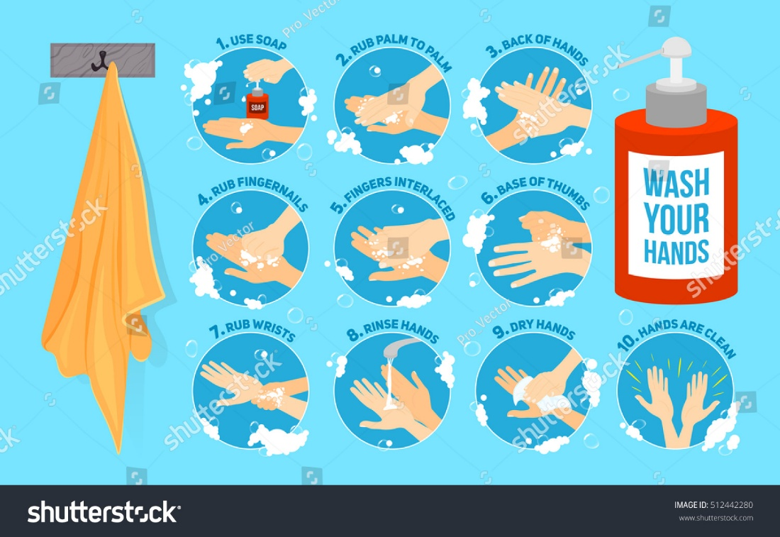
Thank you
A hand hygiene moment is a HAI prevented
HAI prevented is antimicrobial saved
Antimicrobial saved is AMR prevented

Slide 11
References
Debra, A. G., et al. (2012). Healthcare worker hand hygiene compliance and its impact on patient outcomes.
Ndegwa, L., et al. (2019). Hand hygiene compliance in Kenyan hospitals.
Pan American Health Organization. (2021). Hand hygiene:
Technical brief. PAHO. https://www.paho.org
World Health Organization. (2020). Water, sanitation, hygiene and health: A primer for health professionals. https://www.who.int/publications
Pan American Health Organization. (2021). Hand hygiene: Technical brief. https://www.paho.org
UNICEF. (2018). Hand hygiene in health care: Compliance and implementation challenges. https://www.unicef.org
Loise Kihungi, L., et al. (2022, April). Improving compliance with hand hygiene through staff education.

